Slide 1

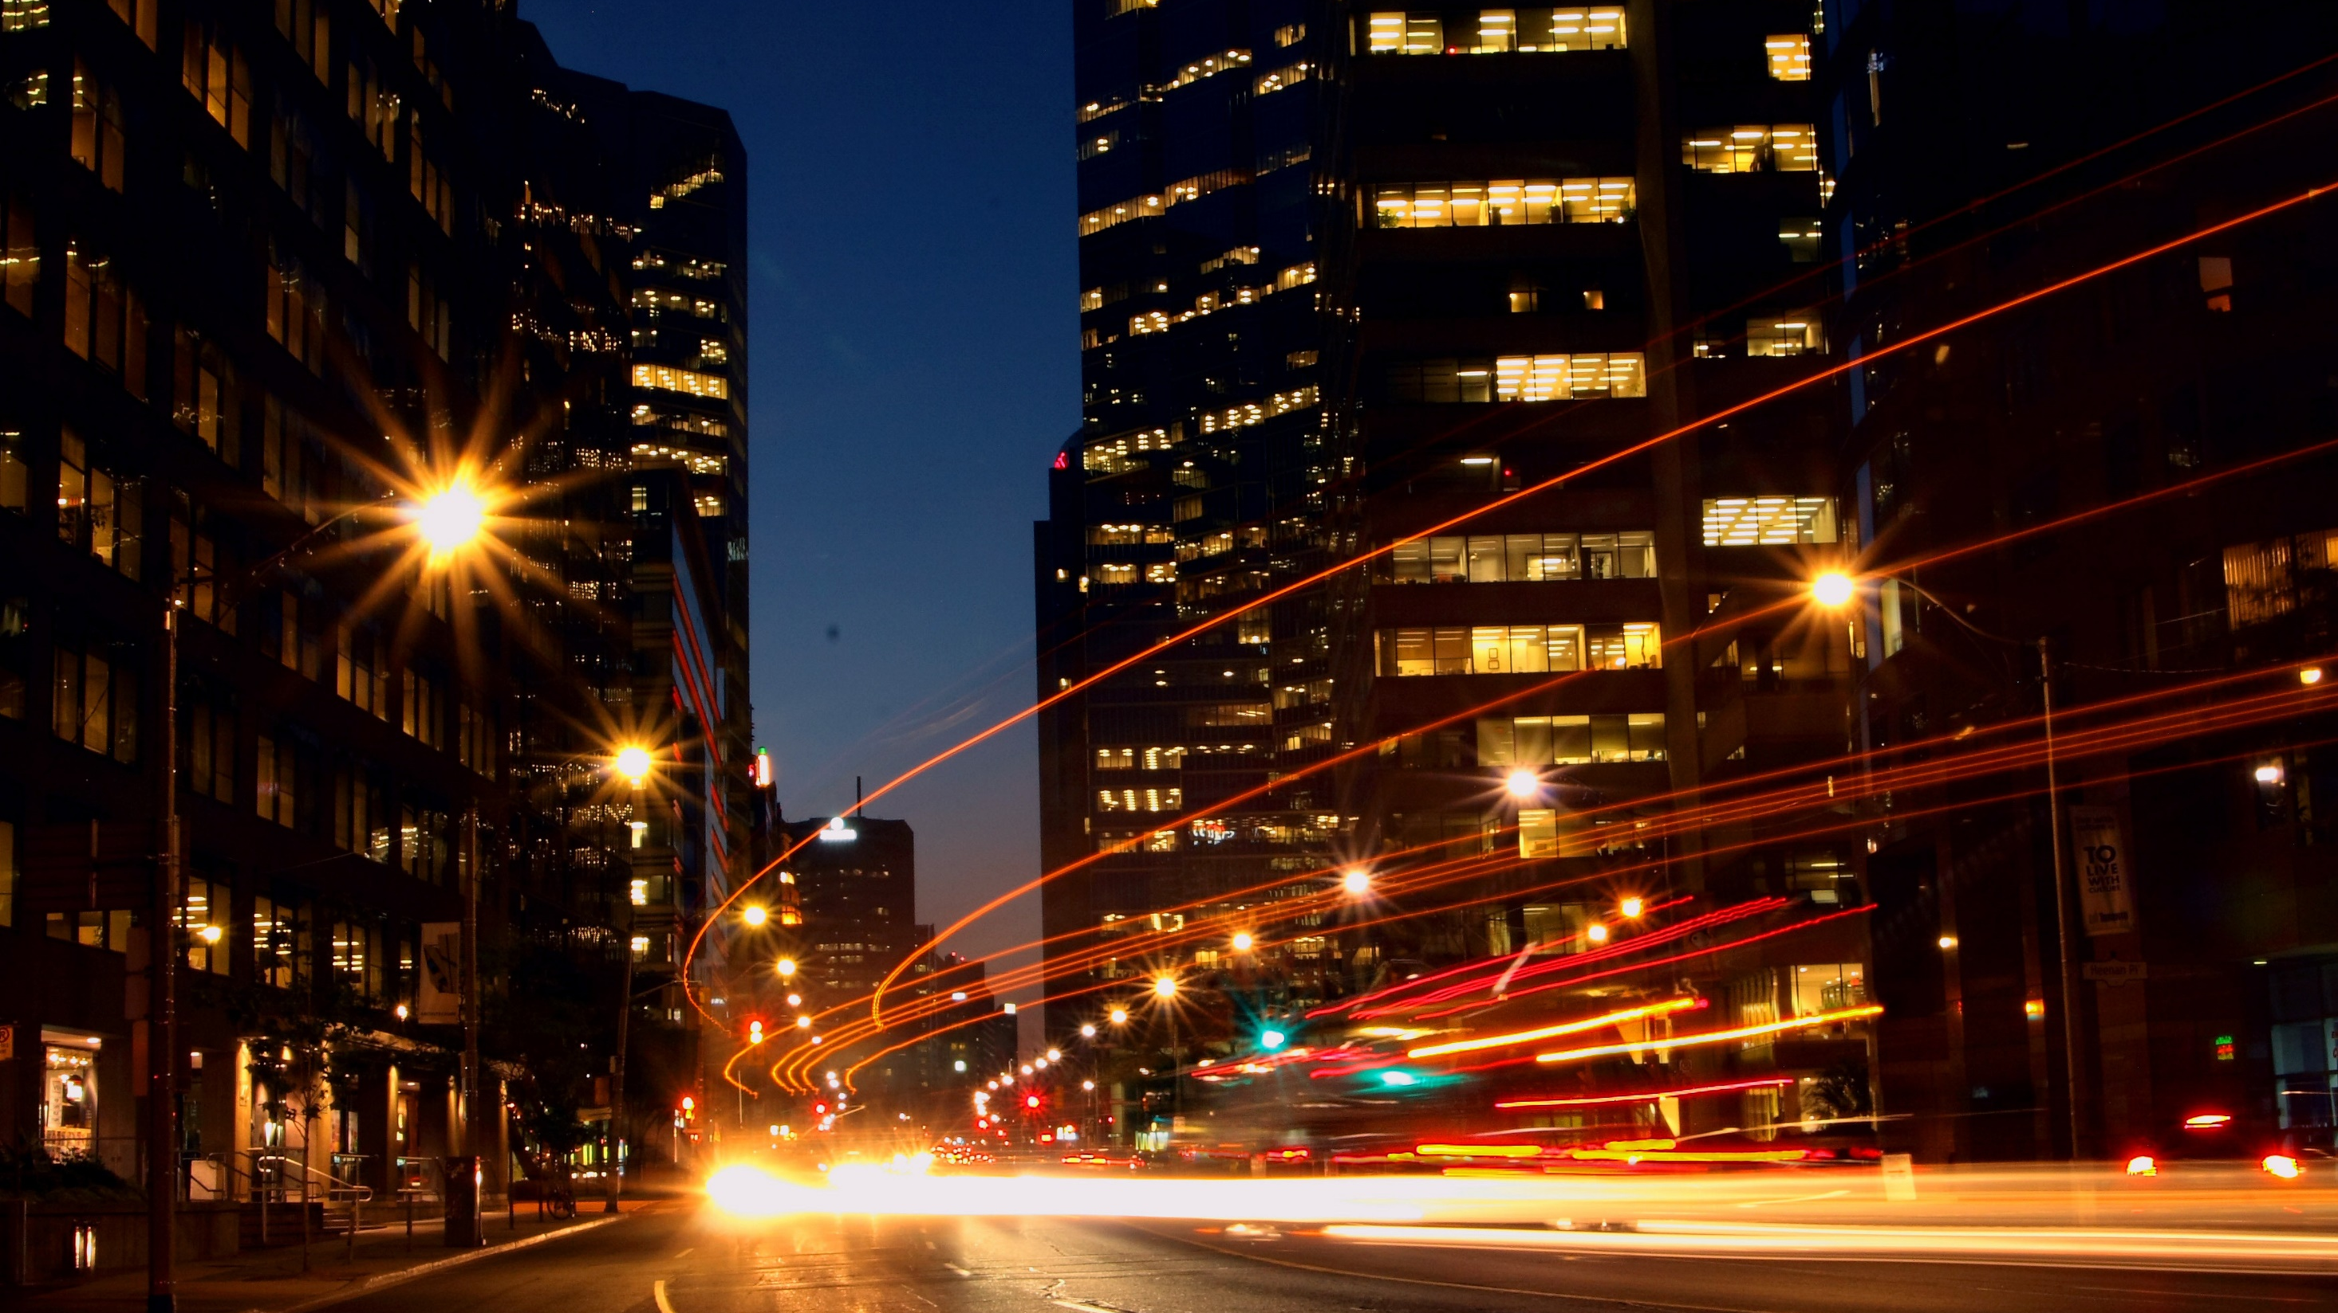
Spatial Data Modeling
& Database Design
Geographical Information System
Chapter - 3

Slide 2
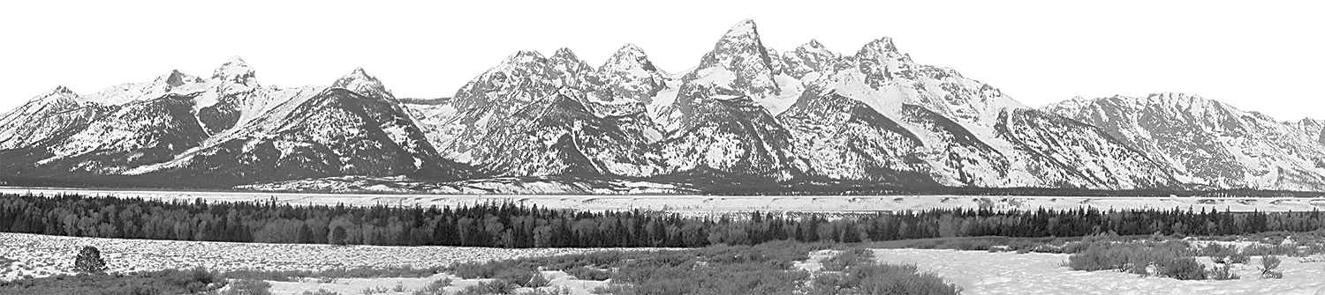
TABLE OF CONTENTS
·
Concepts of geo-database
Spatial DB Design
Vector Model
Raster Model
Digital Terrain Model
Models
Unit 3.4
Unit 3.5
Unit 3.3
Introduction
Topology &
Spatial Relationships
Unit 3.2
Unit 3.1
Geographical Information System

Slide 3
INTRODUCTION
When we want to acquire, store, analyze, visualize, and exchange information about the real world, we use other media and means not just interpersonal communication.
The most common of models are—in historic sequence—maps and databases.
Maps usually have been used to picture real world phenomena, databases can be used to represent real and virtual worlds.
Geographical Information System

Slide 4
INTRODUCTION
When we want to acquire, store, analyze, visualize, and exchange information about the real world, we use other media and means not just interpersonal communication.
The most common of models are—in historic sequence—maps and databases.
Maps usually have been used to picture real world phenomena, databases can be used to represent real and virtual worlds.
Geographical Information System

